Slide 1

Open Data Portal (ODP): Pilot Project
UCB Class Presentation
November 20, 2014

Slide 2

How Will We Spend Our Time?
Open Data Portal
Open Data Apps
Socrata Open Data API

Slide 3
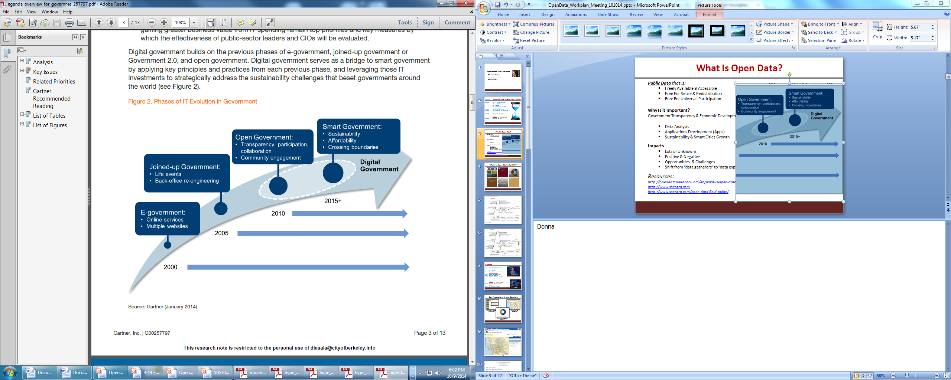
What Is Open Data? Why Is It Important?
Non-Confidential, Public Data that is:
Freely Available & Accessible
Free For Reuse & Redistribution
Free For Universal Participation
Why Is it Important?
Government Transparency
Data Analysis
Economic Development
Applications Development (“Apps”)
Sustainability & Smart Cities IT
Sensors & Data Feeds
Notes:
Government Transparancy – PRA
Economic Development – Zwillow, Transportation apps

Slide 4
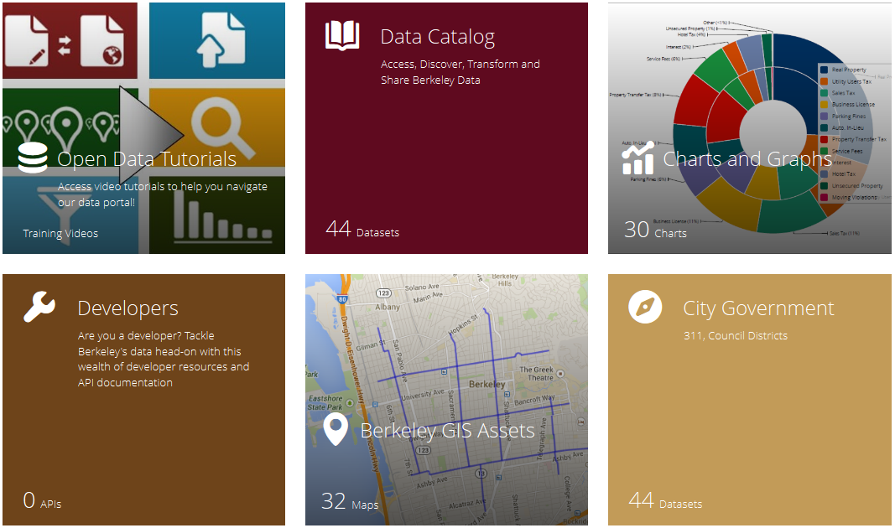
What Is An Open Data Portal (ODP)?

Slide 5
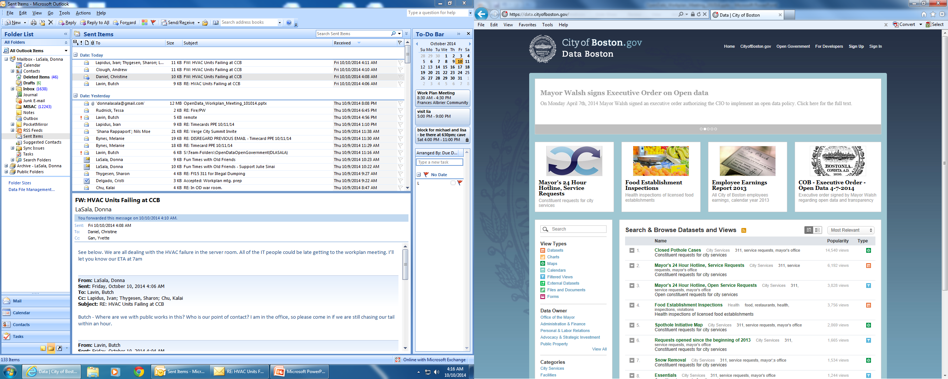
What Are Other Cities Doing and Why?
New York, Chicago, Boston
San Francisco, Alameda County
220+ Cities & 39+ States
Districts/Offices
Resources:
http://opendatahandbook.org
http://www.socrata.com

Slide 6



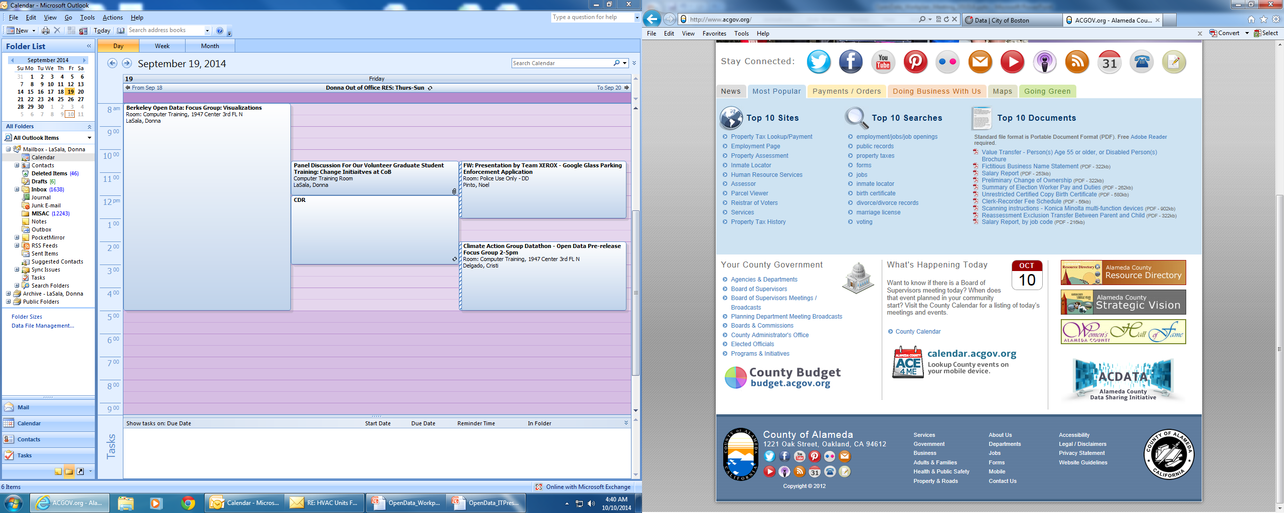
What is CoB Doing?
Pilot Online: 12/15/14 – 6/30/15
Adv Excel + “Office Hours” 3x per week, 12/2
Open Data Open House, 12/16
Council Item 11/18
Hack-A-Thons → Workplan meeting
September & October: City Staff; Climate Action & OED
November & December:
City Staff; Community: Low-Income, Business, Block Captain
Notes:
Data literacy within the city
Open House
Pilot as a means of gathering information

Slide 7
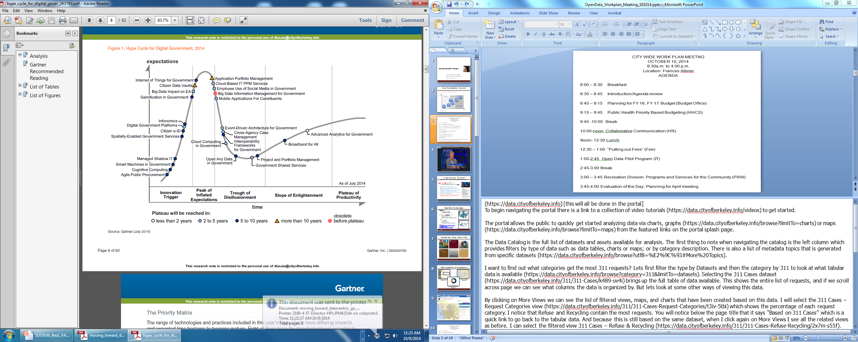
Why Are We Doing This Now?
Notes:
The process begins with a business analysis of the data from enterprise systems to understand the transactions that produce the data and what the intended use for the data is.
For each dataset it is important to know which department is responsible for the data and who the subject-matter expert is. Are there any rules or restrictions regarding the data? And how often is the data updated?
As with all current public data, confidential and sensitive data is never exposed such as social security numbers and private health data. Other data, such as business license reporting only releases high-level data such as gross receipts.

Slide 8
What Questions Can Our ODP Answer?
Notes:
(https://data.cityofberkeley.info) [this will all be done in the portal]
To begin navigating the portal there is a link to a collection of video tutorials (https://data.cityofberkeley.info/videos) to get started.
The portal allows the public to quickly get started analyzing data via charts, graphs (https://data.cityofberkeley.info/browse?limitTo=charts) or maps (https://data.cityofberkeley.info/browse?limitTo=maps) from the featured links on the portal splash page.
The Data Catalog is the full list of datasets and assets available for analysis. The first thing to note when navigating the catalog is the left column which provides filters by type of data such as data tables, charts or maps; or by category description. There is also a list of metadata topics that is generated from specific datasets (https://data.cityofberkeley.info/browse?utf8=%E2%9C%93#More%20Topics).
I want to find out what categories get the most 311 requests? Lets first filter the type by Datasets and then the category by 311 to look at what tabular data is available (https://data.cityofberkeley.info/browse?category=311&limitTo=datasets). Selecting the 311 Cases dataset (https://data.cityofberkeley.info/311/311-Cases/k489-uv4i) brings up the full table of data available. This shows the entire list of requests, and if we scroll across page we can see what columns the data is organized by. But lets look at some other ways of viewing this data.
By clicking on More Views we can see the list of filtered views, maps, and charts that have been created based on this data. I will select the 311 Cases – Request Categories view (https://data.cityofberkeley.info/311/311-Cases-Request-Categories/t3iv-5tbi) which shows the percentage of each request category. I notice that Refuse and Recycling contain the most requests. You will notice below the page title that it says “Based on 311 Cases” which is a quick link to go back to the tabular data. And because this is still based on the same dataset, when I click again on More Views I see all the related views as before. I can select the filtered view 311 Cases – Refuse & Recycling (https://data.cityofberkeley.info/311/311-Cases-Refuse-Recycling/2x7m-s55f). When I click on Filters, you will see that I have applied a filter for the Request Category column to display only rows that contain “refuse”.
What if we wanted to find out how many stolen carts are reported? Under More Views we will find the filtered view Residential & Commercial Stolen Carts (https://data.cityofberkeley.info/311/Residential-Commercial-Stolen-Carts/hjwu-cftq). Which is a filtered view of the 311 Cases by filtering Request Detail to contain “stolen”. This is a complete list of lost or stolen carts and when we look at the column Request Sub Category we can see that there are both Residential and Commercial reports.
Next I want to know how many reports happen to be residential or commercial? Back to More Views, the Residential & Commercial Stolen Carts – Pie Chart (https://data.cityofberkeley.info/311/Residential-Commercial-Stolen-Carts-Pie-Chart/h6ky-syzv) shows the ratio of residential to commercial carts. This visualization was achieved using the Roll Up and Sort functions that are found in the Filter toolbox.
But maybe I want to know where the carts were stolen from? More Views has a map Residential & Commercial Stolen Carts – Map (https://data.cityofberkeley.info/311/Residential-Commercial-Stolen-Carts-Map/xem8-27k2) that pin points the locations. I can apply some conditional formatting with the Filter toolbox so that we can visually identify which locations are residential and which are commercial.
Description = Residential
(Color is yellow)
Condition = Request Sub Category
Select a comparison = is
Residential
Add a New Rule and repeat for Commercial (color is red).
Click Apply to see the changes and Save the view.
One other feature to point out is the Export toolbox. Functions include API access for developers as well as ability to download the tabular data in PDF, CSV or Excel formats.
These are just a few examples of how Open Data can be accessed and utilized in the Open Data portal. We are still in the process of populating the portal with datasets and we will next give you an overview of the process of making that happen.

Slide 9
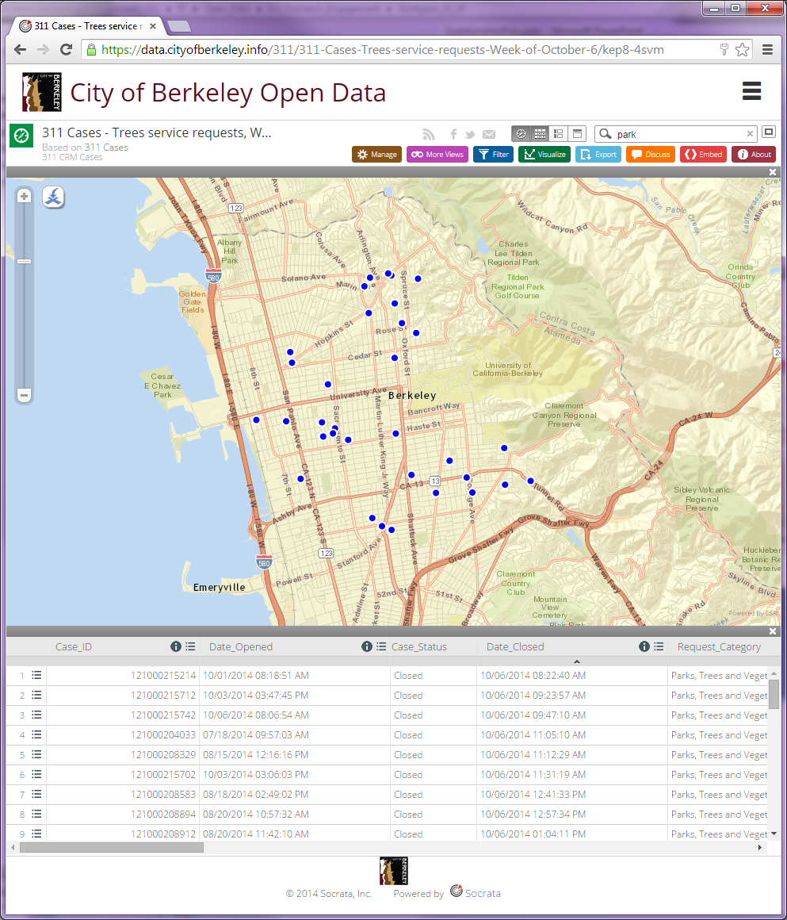
Which Tree SRs Were Closed Last Week?
: 311 Service Requests
Notes:
https://data.cityofberkeley.info/311/311-Cases-Trees-service-requests-Week-of-October-6/kep8-4svm

Slide 10
What Types of Community SRs Does CoB Get?
Notes:
https://data.cityofberkeley.info/311/311-Cases-Totals-by-Request-Category-2013-/sjsv-skzq

Slide 11
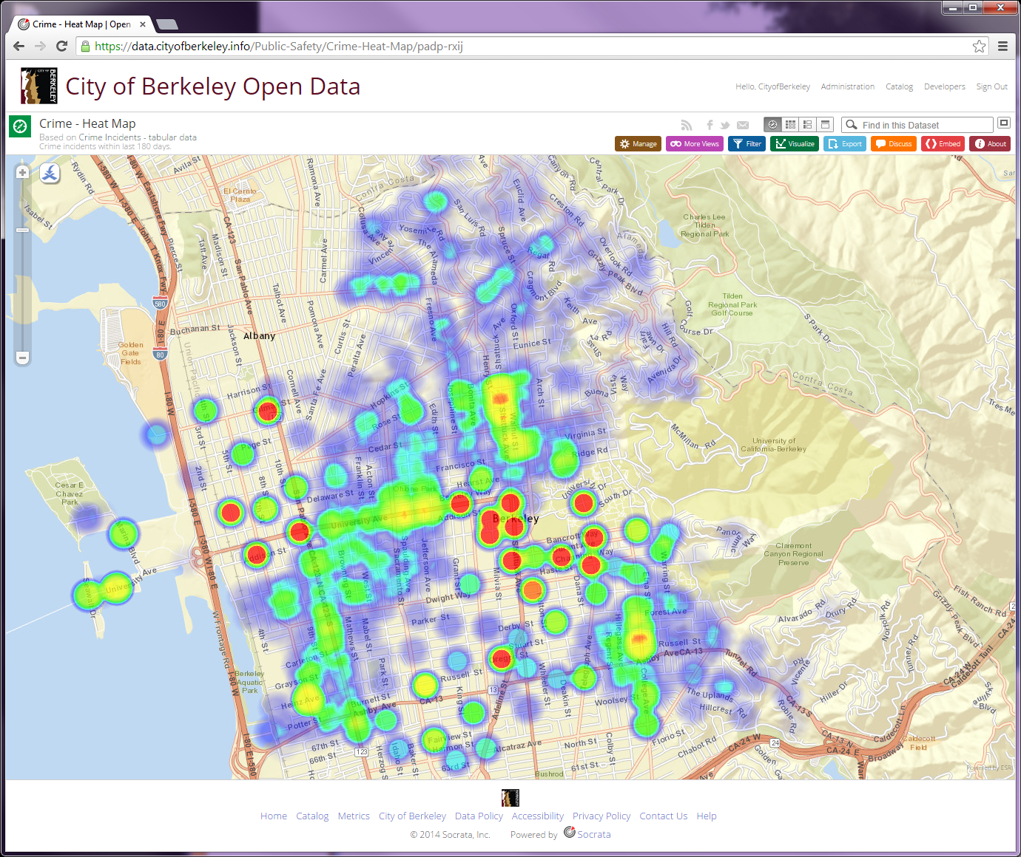
Where Has Crime Occurred Most?
Notes:
https://data.cityofberkeley.info/Public-Safety/Crime-Heat-Map/padp-rxij

Slide 12
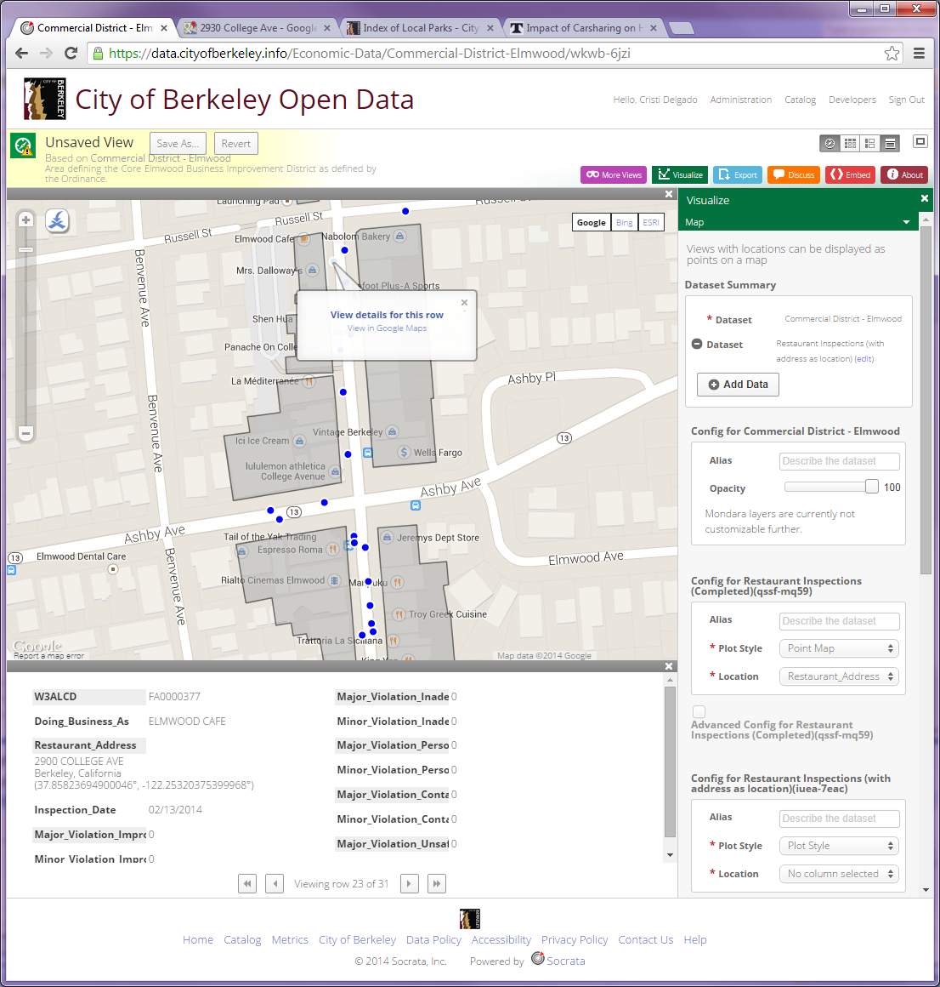
What Are The Inspection Scores For Elmwood Restaurants?
Notes:
https://data.cityofberkeley.info/Economic-Data/Restaurant-Inspection-Results-in-the-Elmwood-Comme/79m8-mxvn

Slide 13
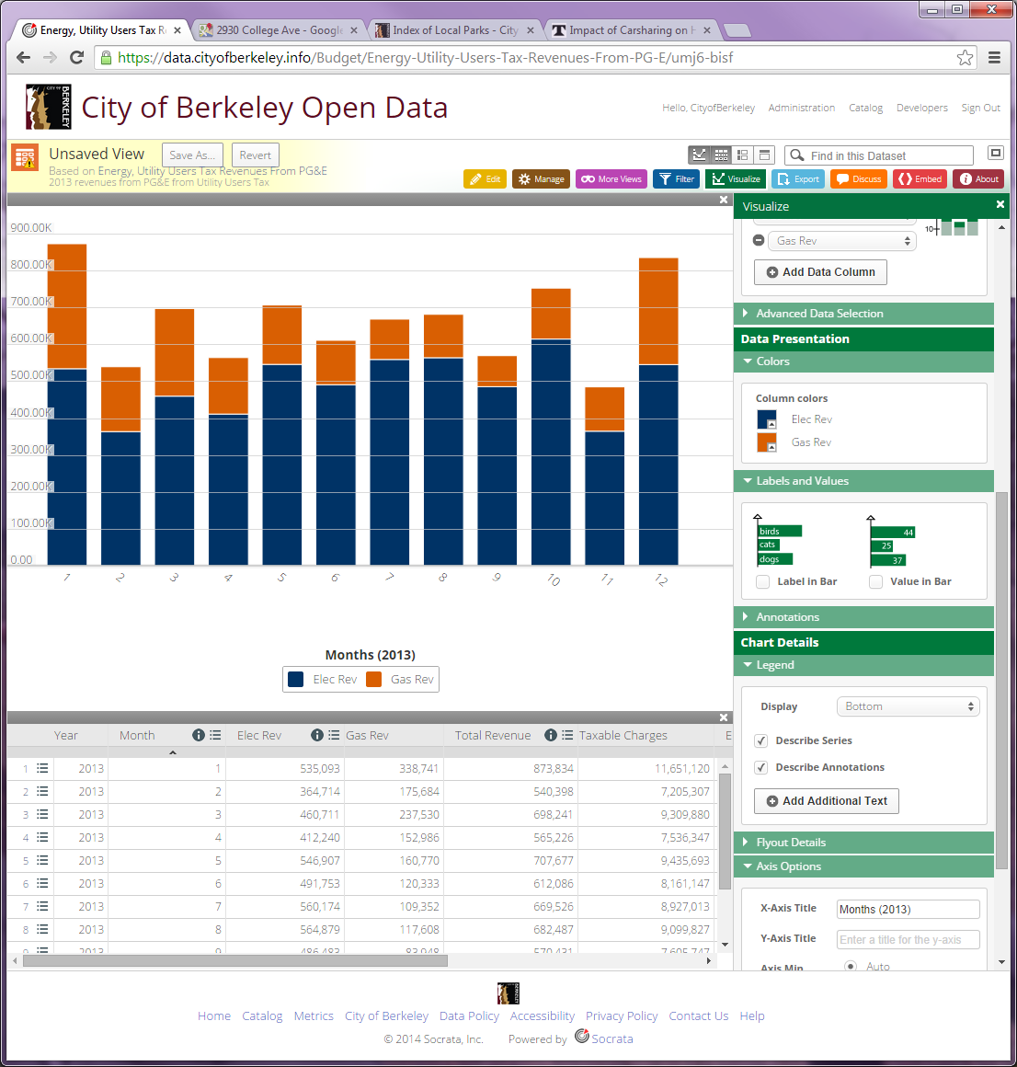
What Was CoB’s Utility Tax Revenue in 2013?
Notes:
https://data.cityofberkeley.info/Budget/Utility-Tax-Revenue-by-month-2013-graph/x3th-5tb4

Slide 14
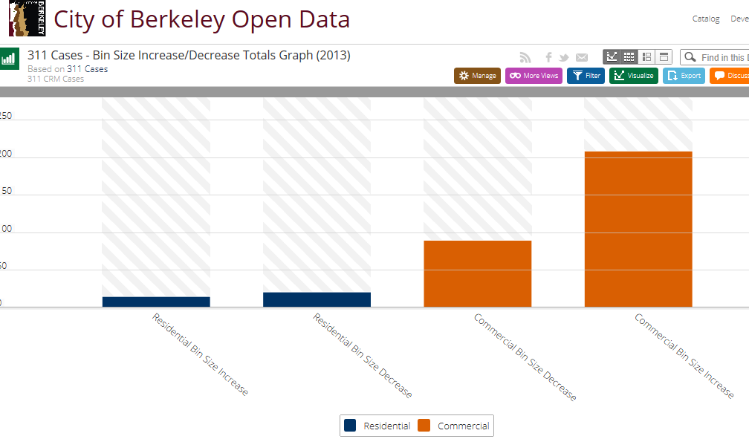
Have Refuse Bin Sizes Increased or Decreased?
Notes:
https://data.cityofberkeley.info/311/311-Cases-Bin-Size-Increase-Decrease-Totals-Graph-/h5ae-e3qy

Slide 15
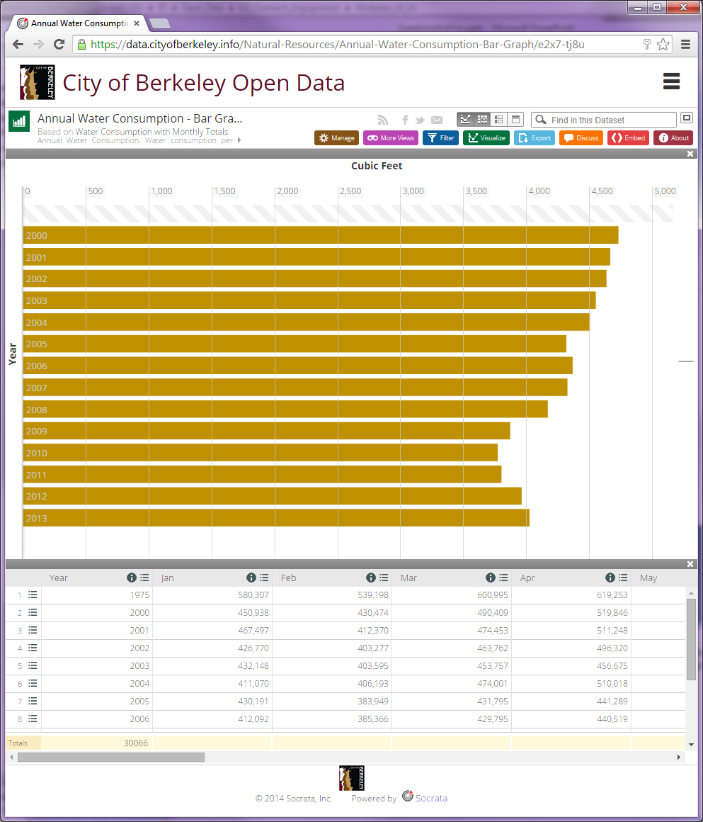
How Much Water Is Used In Berkeley?
Notes:
https://data.cityofberkeley.info/Natural-Resources/Annual-Water-Consumption-Bar-Graph/e2x7-tj8u
Not only can we find the answer in the dataset, https://data.cityofberkeley.info/Natural-Resources/Water-Consumption-with-Monthly-Totals/69c7-ppfm , but we visualize the answer by clicking “More Views”. And, we can download the dataset for further analysis in Excel to answer the question “What is difference in consumption, over the years, between January and July?

Slide 16

Socrata Open Data API (SODA)
Introduction to SODA
OpenBudget, Open311
How To
Example

Slide 17
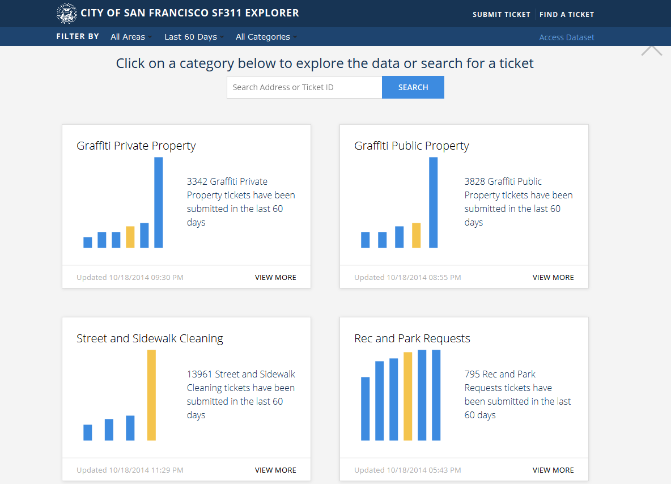
SF311 Explorer App – Built on SF’s ODP using SODA

Slide 18
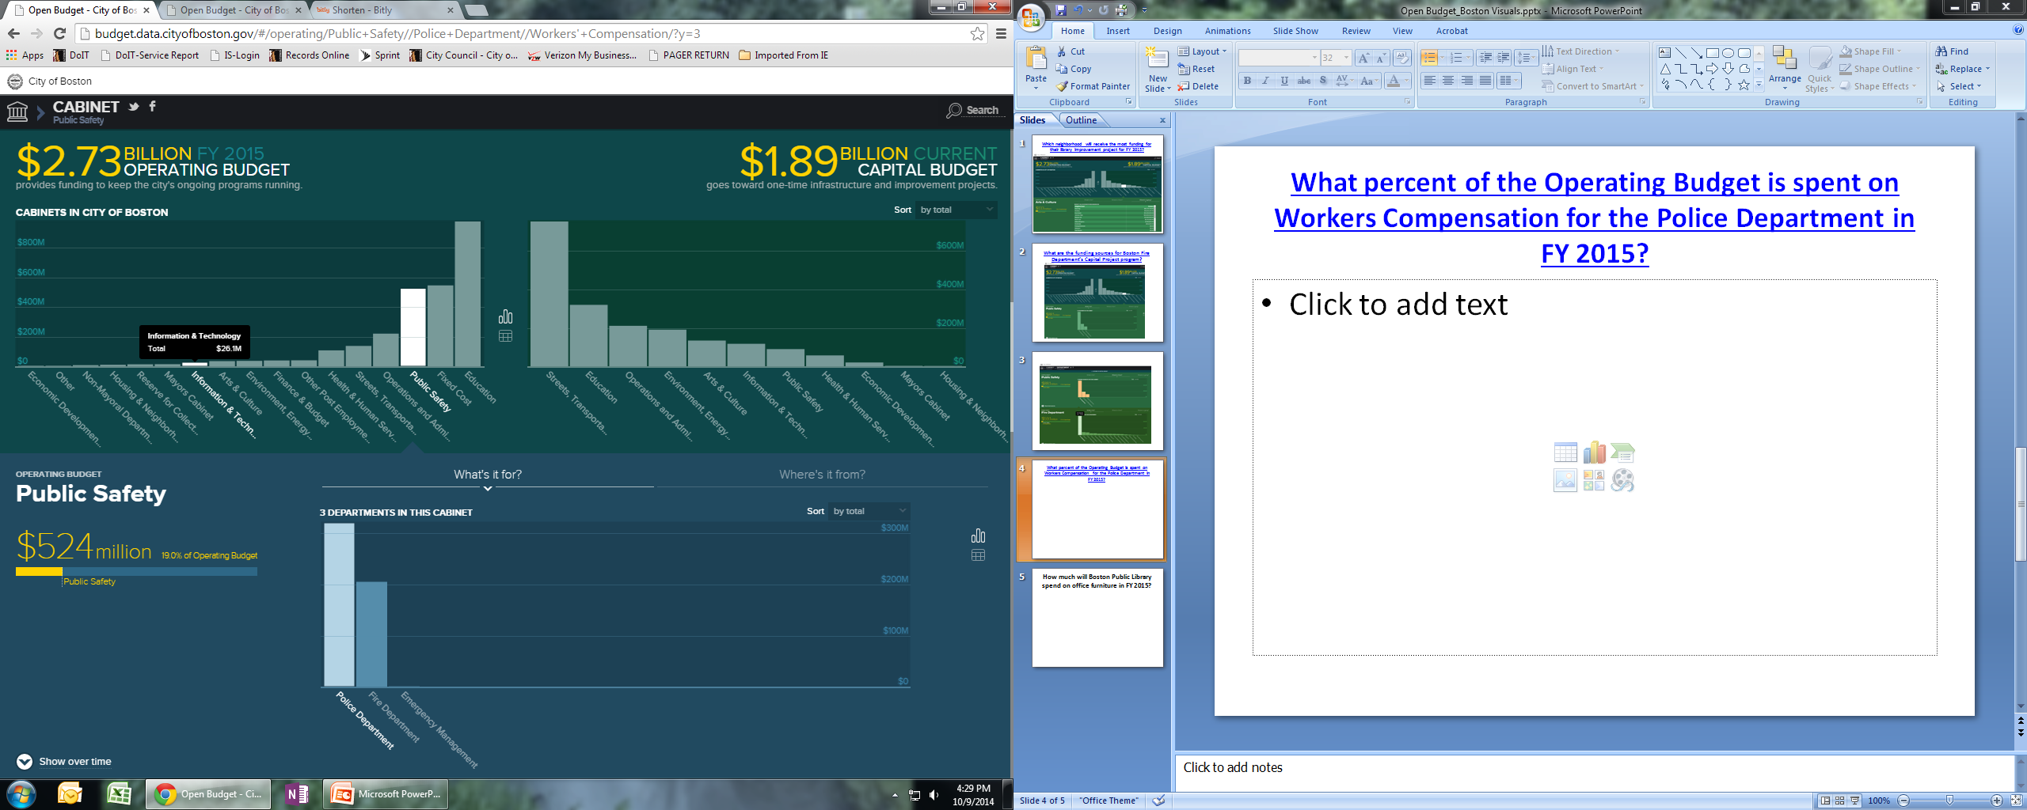
Boston’s Open Budget App – Built on their ODP using SODA

Slide 19
API Endpoints
Format:
https://$domain/resource/$identifier.$ext
http://socrata.github.io/presentations/hackathons/2014-05-31-ndoch/#/

Slide 20
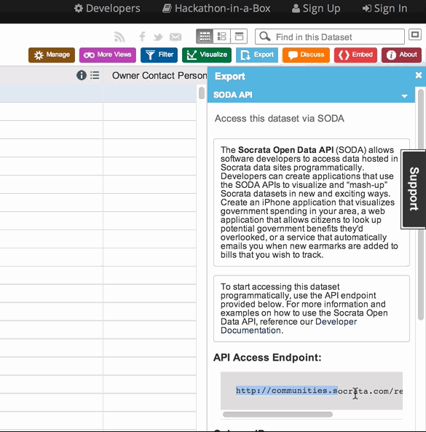
In the Open Data Catalog

Slide 21
Simple Filters
/https://data.cityofberkeley.info/resource/j67x-ew72.json?dba=JUPITER
[ {
"workdescription" : "RESTAURANT/MICRO BREWERY",
"naics" : "711110 - Theater Companies and Dinner Theaters",
"rec_date" : "2013-08-30T00:00:00",
"businesstype" : "Retail Trade",
"dba" : "JUPITER“
}}, ... ]
For more info: dev.socrata.com/docs/filtering.html
Notes:
Each column in the dataset is represented by a single field in its SODA API. Using filters and SoQL queries, you can search for records, limit your results, and change the way the data is output. For example, you could filter this dataset by its recordid field using a query like the following:
https://data.cityofberkeley.info/resource/j67x-ew72.json?recordid=BL-053398

Slide 22
SoQL Queries
https://data.cityofberkeley.info/resource/kw74-4a6x.json?$where=base_pay>100000
For more info: dev.socrata.com/docs/queries.html
Notes:
For richer filtering, you can combine filters together by stacking parameters on your URL or by using SoQL queries.

Slide 23
Geo Queries
/resource/abcd-1234.json? $where=within_circle(location, 47.61, -122.32, 500)
For more info: dev.socrata.com/docs/datatypes/location.html

Slide 24
Socrata Sample Docs
http://dev.socrata.com/foundry/#/data.cityofberkeley.info/j67x-ew72
https://live-docs.socrata.com/data.cityofberkeley.info/j67x-ew72
Notes:
User friendly interface to build your query url

Slide 25
City of Berkeley Sample App
http://cobinspections.azurewebsites.net/

Slide 26

Thank You For Your Time!
ODP Pilot Project: Questions?

Slide 27
How Do We Get Data Ready?
Transactional Data
Business
Analysis
Metadata & Documentation
Data Modeling & SQL Development
Quality Assurance & Control
ETL
Deployment
Which department is the data owner?
Which Systems/s create/process/store the data?
Which staff member is the subject-matter expert?
What are the business rules regarding this data?
How often (frequency) is the data updated?
Notes:
Data readying is the process of transforming existing transactional data to be published into the Open Data portal allowing for public access.
In the next slides we will explain the details of the process that you see here from collecting and analyzing the data from legacy and enterprise systems to deploying it to the portal.

Slide 28
What Questions Can Our ODP Answer?
1. Which Tree SRs Were Closed Last Week?
2. What Types of Community SRs Does CoB Get?
3. Where Has Crime Occurred Most?
4. What Are The Inspection Scores For Elmwood Restaurants?
5. What Was CoB’s Utility Tax Revenue in 2013?
6. Have Refuse Bin Sizes Increased or Decreased?
7. How Much Water Is Used In Berkeley?

Slide 29
Hands-On: Follow Along With Cristi
Notes:
(https://data.cityofberkeley.info) [this will all be done in the portal]
To begin navigating the portal there is a link to a collection of video tutorials (https://data.cityofberkeley.info/videos) to get started.
The portal allows the public to quickly get started analyzing data via charts, graphs (https://data.cityofberkeley.info/browse?limitTo=charts) or maps (https://data.cityofberkeley.info/browse?limitTo=maps) from the featured links on the portal splash page.
The Data Catalog is the full list of datasets and assets available for analysis. The first thing to note when navigating the catalog is the left column which provides filters by type of data such as data tables, charts or maps; or by category description. There is also a list of metadata topics that is generated from specific datasets (https://data.cityofberkeley.info/browse?utf8=%E2%9C%93#More%20Topics).
I want to find out what categories get the most 311 requests? Lets first filter the type by Datasets and then the category by 311 to look at what tabular data is available (https://data.cityofberkeley.info/browse?category=311&limitTo=datasets). Selecting the 311 Cases dataset (https://data.cityofberkeley.info/311/311-Cases/k489-uv4i) brings up the full table of data available. This shows the entire list of requests, and if we scroll across page we can see what columns the data is organized by. But lets look at some other ways of viewing this data.
By clicking on More Views we can see the list of filtered views, maps, and charts that have been created based on this data. I will select the 311 Cases – Request Categories view (https://data.cityofberkeley.info/311/311-Cases-Request-Categories/t3iv-5tbi) which shows the percentage of each request category. I notice that Refuse and Recycling contain the most requests. You will notice below the page title that it says “Based on 311 Cases” which is a quick link to go back to the tabular data. And because this is still based on the same dataset, when I click again on More Views I see all the related views as before. I can select the filtered view 311 Cases – Refuse & Recycling (https://data.cityofberkeley.info/311/311-Cases-Refuse-Recycling/2x7m-s55f). When I click on Filters, you will see that I have applied a filter for the Request Category column to display only rows that contain “refuse”.
What if we wanted to find out how many stolen carts are reported? Under More Views we will find the filtered view Residential & Commercial Stolen Carts (https://data.cityofberkeley.info/311/Residential-Commercial-Stolen-Carts/hjwu-cftq). Which is a filtered view of the 311 Cases by filtering Request Detail to contain “stolen”. This is a complete list of lost or stolen carts and when we look at the column Request Sub Category we can see that there are both Residential and Commercial reports.
Next I want to know how many reports happen to be residential or commercial? Back to More Views, the Residential & Commercial Stolen Carts – Pie Chart (https://data.cityofberkeley.info/311/Residential-Commercial-Stolen-Carts-Pie-Chart/h6ky-syzv) shows the ratio of residential to commercial carts. This visualization was achieved using the Roll Up and Sort functions that are found in the Filter toolbox.
But maybe I want to know where the carts were stolen from? More Views has a map Residential & Commercial Stolen Carts – Map (https://data.cityofberkeley.info/311/Residential-Commercial-Stolen-Carts-Map/xem8-27k2) that pin points the locations. I can apply some conditional formatting with the Filter toolbox so that we can visually identify which locations are residential and which are commercial.
Description = Residential
(Color is yellow)
Condition = Request Sub Category
Select a comparison = is
Residential
Add a New Rule and repeat for Commercial (color is red).
Click Apply to see the changes and Save the view.
One other feature to point out is the Export toolbox. Functions include API access for developers as well as ability to download the tabular data in PDF, CSV or Excel formats.
These are just a few examples of how Open Data can be accessed and utilized in the Open Data portal. We are still in the process of populating the portal with datasets and we will next give you an overview of the process of making that happen.

Slide 30
What Questions Can Our ODP Answer?
1. Which Tree SRs Were Closed Last Week?
2. What Types of Community SRs Does CoB Get?
3. Where Has Crime Occurred Most?
4. What Are The Inspection Scores For Elmwood Restaurants?
5. What Was CoB’s Utility Tax Revenue in 2013?
6. Have Refuse Bin Sizes Increased or Decreased?
7. How Much Water Is Used In Berkeley?

Slide 31
What Questions can the Open 311 App Answer?
What percentage of service requests have been for Street and Sidewalk Cleaning in the past 90 days?
How many Damaged Property tickets were opened in the past 60 days?
What is the percentage change between open and closed tickets for Graffiti Public Property in the past 30 days compared to the past year?
How many General Request tickets were closed in the past 180 days?
What is the ratio of open to closed Streetlight tickets in the past 60 days?

Slide 32
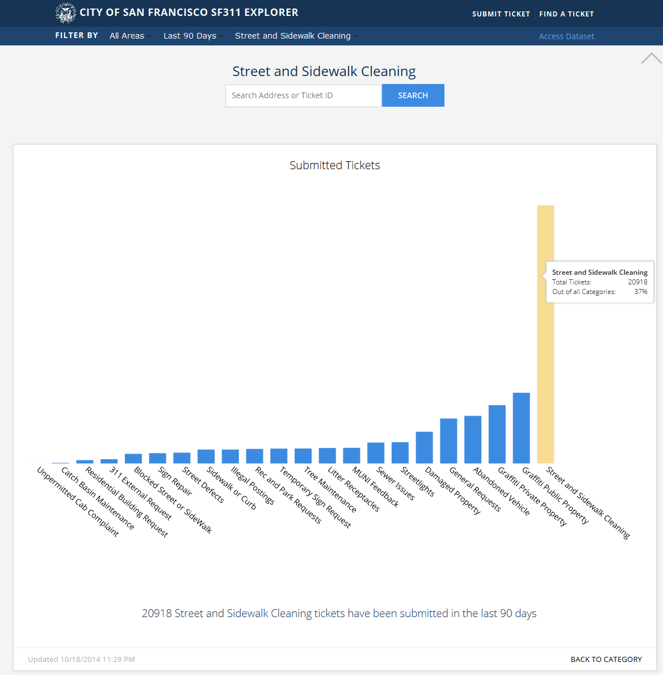
What percentage of service requests have been for Street and Sidewalk Cleaning in the past 90 days?

Slide 33
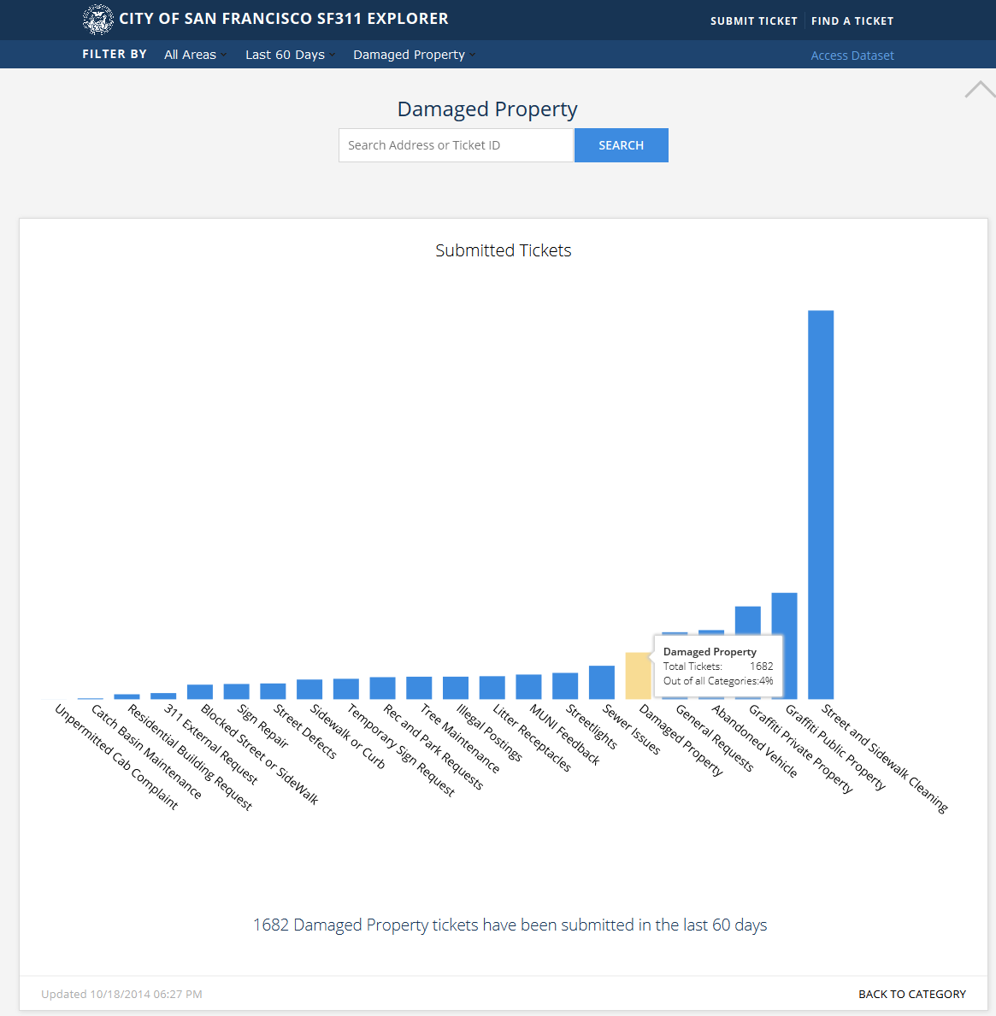
How many Damaged Property tickets were opened in the past 60 days?

Slide 34
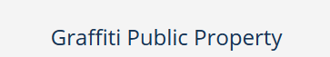
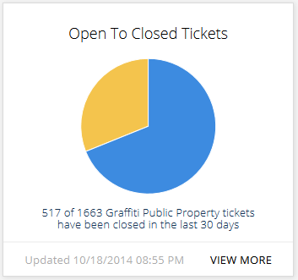
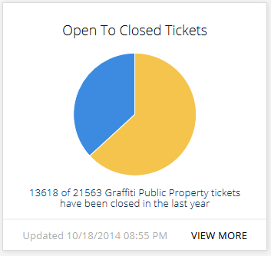
What is the % change between open and closed tickets for Graffiti Public Property in the past 30 days compared to the past year?

Slide 35
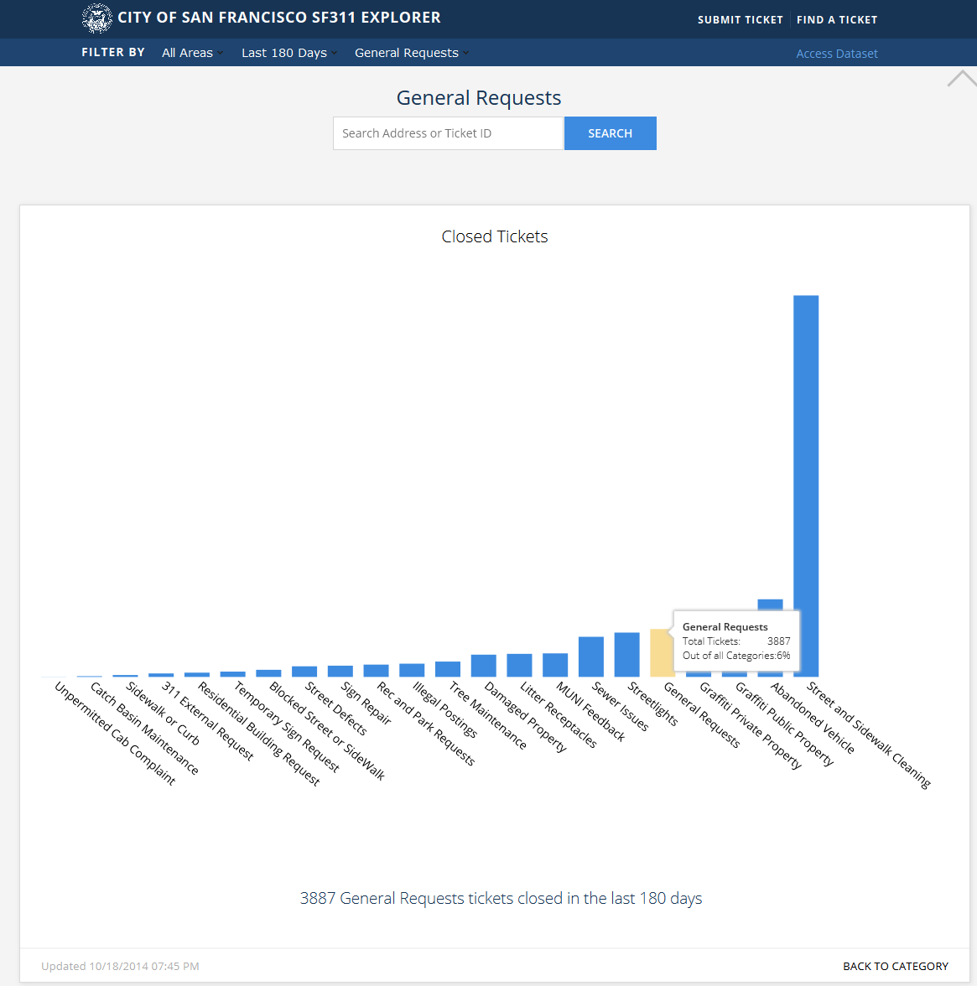
How many General Request tickets were closed in the past 180 days?

Slide 36
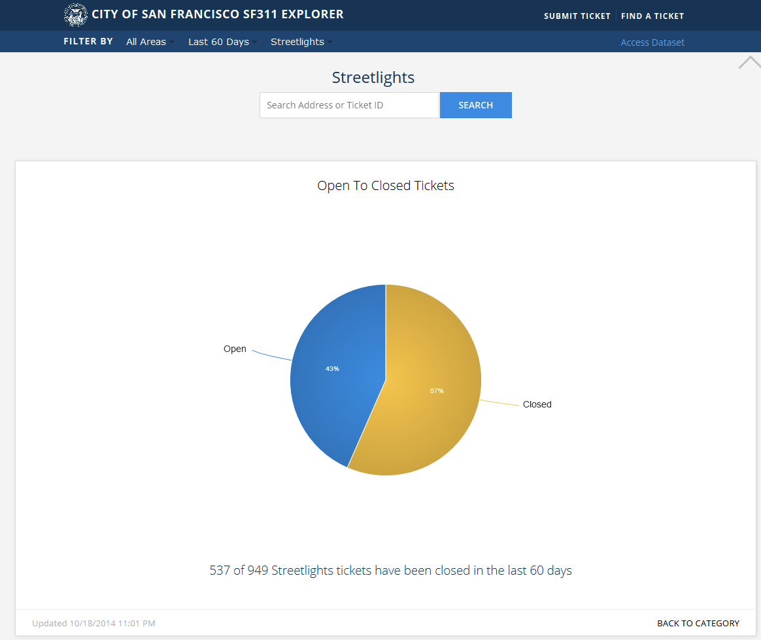
What is the ratio of open to closed Streetlight tickets in the past 60 days?

Slide 37
What Questions can the Open 311 App Answer?
What percentage of service requests have been for Street and Sidewalk Cleaning in the past 90 days?
How many Damaged Property tickets were opened in the past 60 days?
What is the percentage change between open and closed tickets for Graffiti Public Property in the past 30 days compared to the past year?
How many General Request tickets were closed in the past 180 days?
What is the ratio of open to closed Streetlight tickets in the past 60 days?

Slide 38
What Questions Can Our Open Budget App Answer?
Capital Improvement Sample Questions:
Which neighborhood will receive the most funding for their library improvement project for FY2015?
What are the funding sources for the Education department’s Capital Improvement Project?
What percent of the Capital Budget belongs to Health & Human Services?
Which department holds the most Streets, Transportation and Sanitation projects?
What are the funding sources for Boston fire department’s Capital Project program?
What percent of the Capital Budget belongs to Environment, Energy & Open Space?
Operating Budget Sample Questions:
Which department will spend the largest proportion of Boston’s Operating Budget in FY 2015?
How much does Boston plan to spend on Other Post Employment Benefits in FY 2015?
What percent of the Operating Budget is spent on Workers Compensation for the Police Department?
Which department will spend the smallest percentage of Boston’s Operating Budget in FY 2015?
Which fund is the primary source of funding for the Law Department in the Mayor’s Cabinet?
How much will Boston Public Library spend on office furniture in FY 2015?

Slide 39
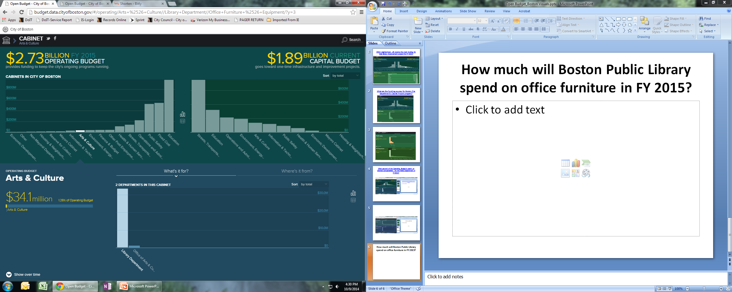
How much will Boston Public Library spend on office furniture in FY 2015?

Slide 40
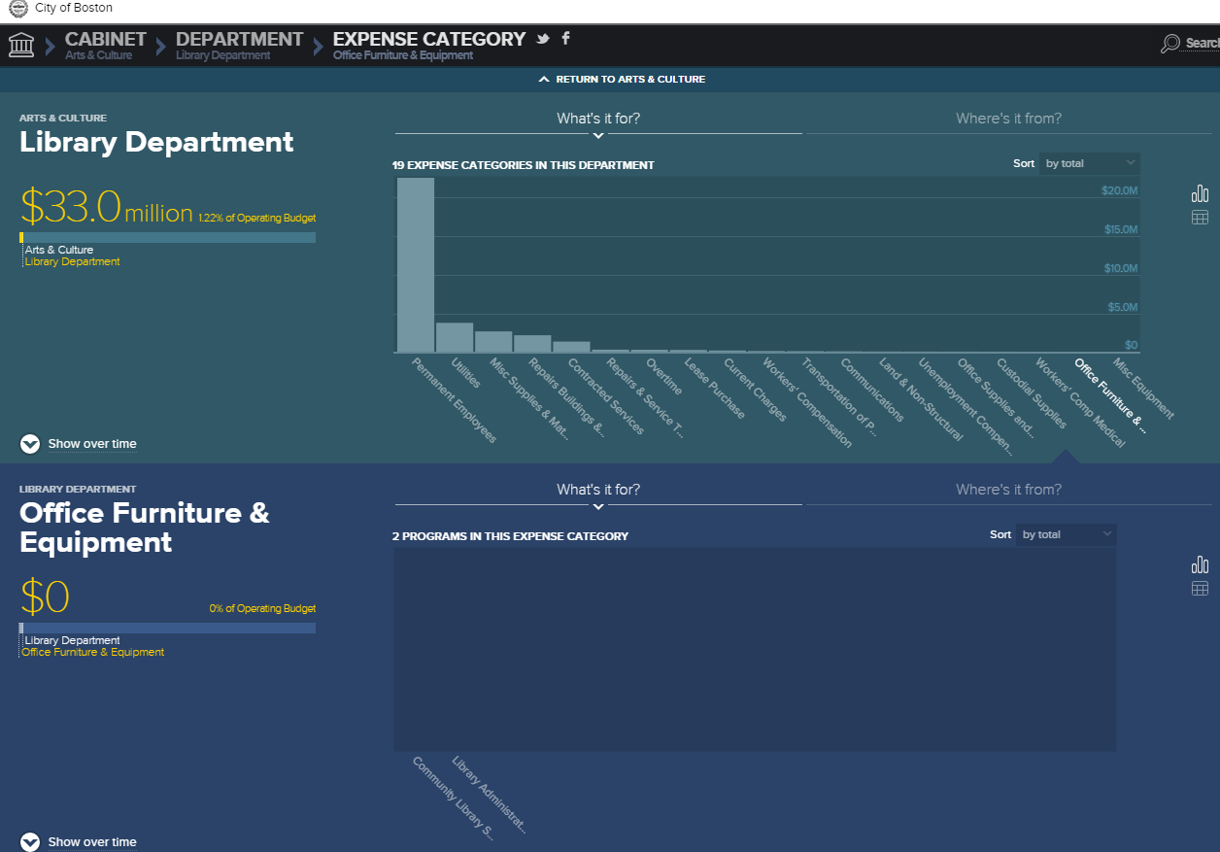

Slide 41
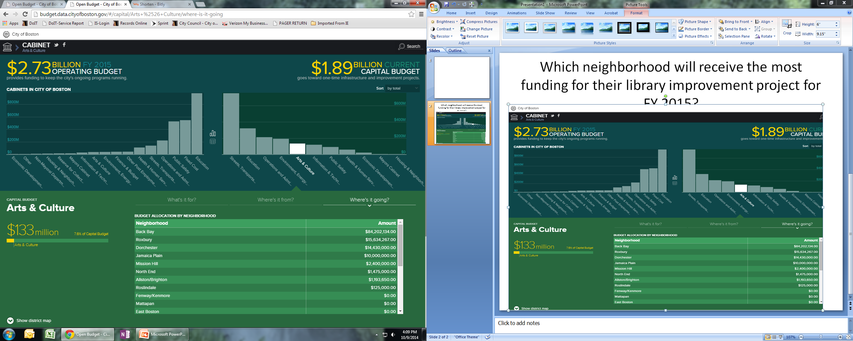
Which neighborhood will receive the most funding for their library improvement project for FY 2015?

Slide 42
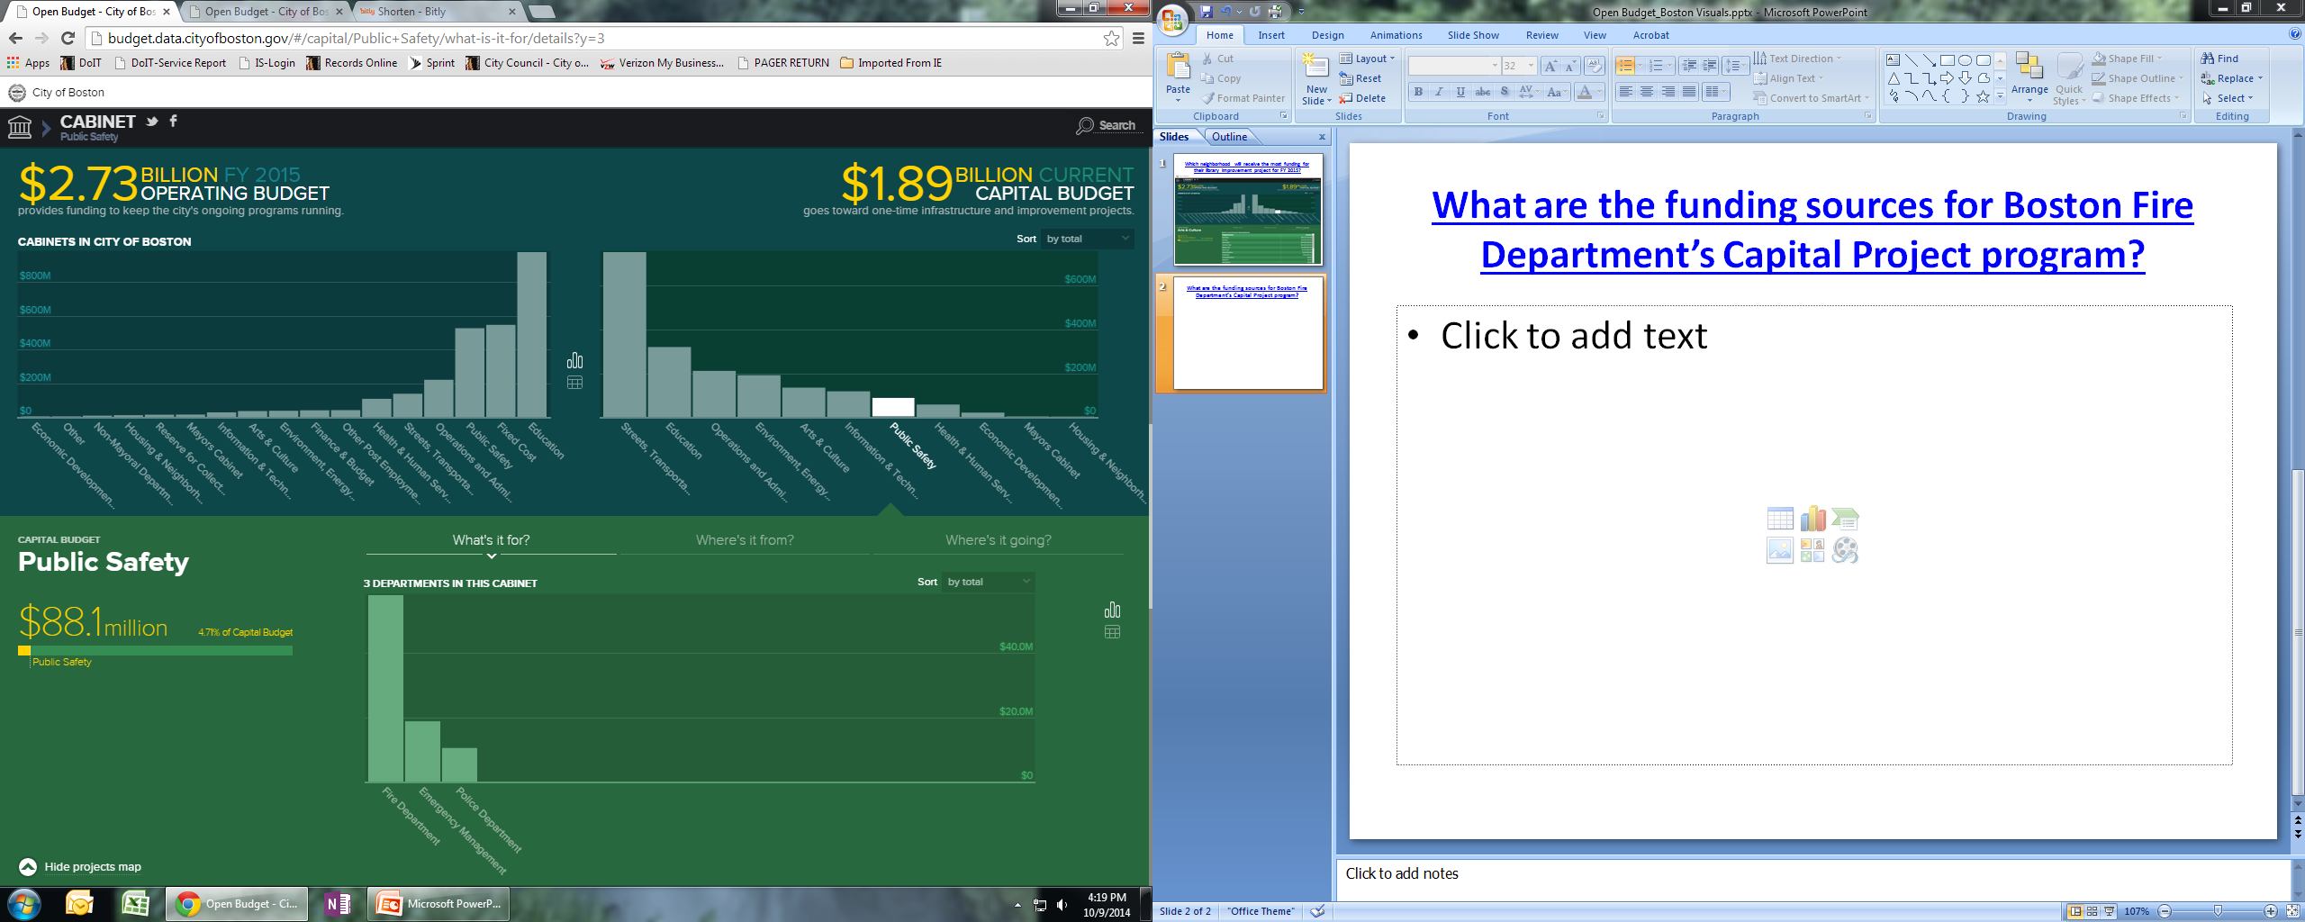
What are the funding sources for Boston Fire Department’s Capital Project program?

Slide 43
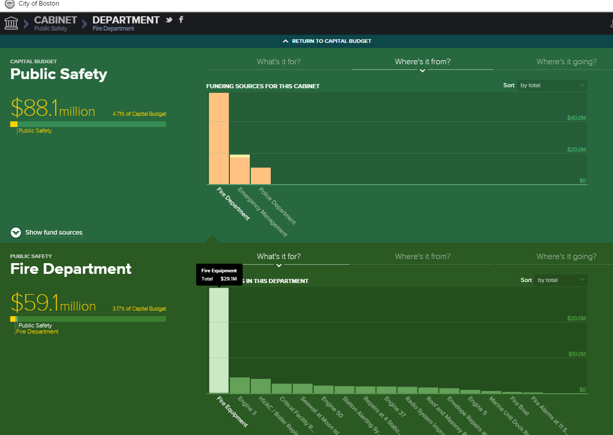

Slide 44
What Questions Can Our Open Budget App Answer?
Capital Improvement Sample Questions:
Which neighborhood will receive the most funding for their library improvement project for FY2015?
What are the funding sources for the Education department’s Capital Improvement Project?
What percent of the Capital Budget belongs to Health & Human Services?
Which department holds the most Streets, Transportation and Sanitation projects?
What are the funding sources for Boston fire department’s Capital Project program?
What percent of the Capital Budget belongs to Environment, Energy & Open Space?
Operating Budget Sample Questions:
Which department will spend the largest proportion of Boston’s Operating Budget in FY 2015?
How much does Boston plan to spend on Other Post Employment Benefits in FY 2015?
What percent of the Operating Budget is spent on Workers Compensation for the Police Department?
Which department will spend the smallest percentage of Boston’s Operating Budget in FY 2015?
Which fund is the primary source of funding for the Law Department in the Mayor’s Cabinet?
How much will Boston Public Library spend on office furniture in FY 2015?

